Slide 1


    Automatic Pet Feeder
Product Design Specifications
  Performance
Scheduled, discrete portion food delivery, with delivery times and quantities to be adjusted by the owner.
Typical use is for a 5-day supply of food.
Must be stable, not easily tipped over.
Easy to clean, no crevices to collect dirt.
Easy to lift and move.
Function reliably, doesn’t plug up.
Suitable for dogs or cats, depending on settings.
Operates on 120VAC transformer with battery backup.
Food storage container/bin resists “unauthorized” entry.
Up to four delivery times per 24-hour period.
Up to 8 cups dry measure of food per delivery.
Able to function in a carport or sheltered outdoor location.
Storage for 20 lbs of dry food.

Slide 2

  Environment
    Withstands humidity levels to 100%
    Able to operate at temperatures from 20 to 120 deg. F
    Not intended for direct exposure to weather (rain)
    Withstand being pushed over and impacting on a hard surface.
    Withstand exposure to airborne dust and sand particles.
    External surfaces shall be impervious to solvents, detergents and oils.
  Service Life
    90% of units sold to residential consumers shall survive 5 years.
    90% of units sold to commercial users shall survive 3.5 years.
  Maintenance
Exterior surfaces shall withstand ordinary household cleaners and solvents
Replacement of backup batteries shall be required no more than once every two years.
Digital control adjustments are only required when the owner wishes to change feed delivery schedule settings

Slide 3
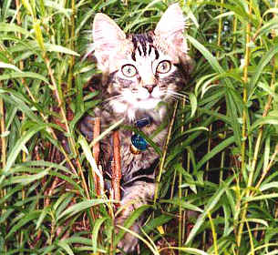
  Target Production Cost
  Based on customer preferences identified during a market survey,
  the target production cost is $18.00 per unit.
  Competition
Market place parameters have been determined by a preliminary market survey, and the following competing products have been identified:
LeBistro $29.99 (bin)
Doskocil Self Feeder $ 9.99 (bin)
AutoPet Feeder $39.95 (timer)

Slide 4
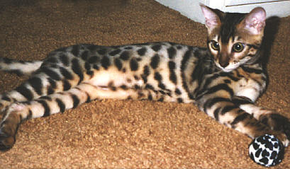
  Distribution (Shipping)
    The product shall be distributed through existing sales channels. Sales and shipping department representatives shall be included in the design review process; their input shall be solicited by the design team.
    The 1-unit shipping weight shall be no more than 20 lbs, and the 6-unit shipping weight shall be no more than 90 lbs. Package dimensions shall conform to standard limits of United Parcel Service, Inc.
    Product shall be sold to distributors in palletized quantities of like product. Palletized quantity packages shall conform to size and weight restrictions from three nationwide freight carriers.
  Packaging
    Shipping and retail display packaging design shall be performed in accordance with organization policy regarding the involvement of marketing, sales, manufacturing and shipping departments.
    Packaging shall provide protection from damage due to dropping from a height of 4 feet, and shall withstand vertical stacking of three units high.

Slide 5

  Quantity
    Production volume has been determined based on the result of a market study. The production target is as follows:
    Quarter before product release: 100 units
    First quarter of production: 200 units
    Second quarter: 500 units
    Thereafter: 600 units (per quarter)
    The production targets shall be modified in accordance with organization policies regarding minimum order quantities, order filling rates, backorder toleration, retailer stocking requirements, distributor stocking requirements, warranty exchange processing rates, and just-in-time manufacturing procedures. The production targets shall be further modified during production by the sales department using sales projections based on market penetration data.
  Marketing system
Distribution of product shall be provided by an existing distributor network, direct-marketing retailers, chain pet supply stores, and internet/mail order.
Design licensing or sale of unbranded product ("private label" sales) shall be permitted after management review of market conditions.

Slide 6
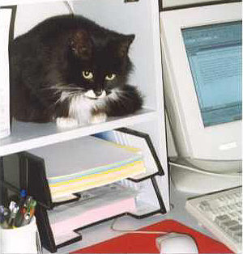
  Manufacturing Facility
    Manufacturing representatives must be present on the design team.
    Injection molded components - injection molding machines required.
    Assembly of plastic and electromechanical components capacity exists for the following:
    -glued plastic joints
    -Torx® bit fasteners
    Packaging shall be performed at plant locations specified by a joint determination made by representatives of marketing and manufacturing.
    Literature shall be produced by contracted printing services at locations near packaging plants
    Size and shape
Maximum envelope for the shipping container is 2x2x3 feet
Maximum envelope for the device is 1x1.5x2 feet
Surfaces shall not have textures that tend to accumulate dirt, intersections of surfaces shall be filleted to avoid crevices that collect dirt.

Slide 7

  Weight
    Finished product weight shall be no more than 14 lbs empty.
    Shipping weights shall conform to maximums of 20 lbs for single pack, 90 lbs for 6-pack.
    OSHA/NIOSH standards shall apply to packaged product.
Aesthetics
Color, texture, finish, form:
Product shall exhibit neutral colors to fit most home interiors and to hide dirt.
The exterior texture and finish shall be free of crevices, folds that might collect dirt, and interior corners shall be filleted for the same purpose.
The cosmetic design of the exterior shall be performed by a contracted aesthetics consultant. The contract administration will be performed by the marketing department.

Slide 8

  Materials
    Non-toxic, plastic exterior must be U/V resistant.
    Materials will be PVC or ABS for the feed dish part,
    Storage bin will be transparent polycarbonate.
    Materials shall be selected for use in roto-molding or injection molding as needed.
    Materials must withstand cleaners and household solvents.
    Machinery must be designed to withstand 100% humidity levels.
    Electronic timing mechanisms must be potted in epoxy or other NEMA-approved waterproofing material.
    Materials used shall be determined on a component-by-component basis. Availability, proximity to manufacturing plants, user survey results, processing constraints, aesthetic considerations and organization standards shall be identified and incorporated into the material selection process.
  Product life span
Product market cycle life is estimated at 15 years

Slide 9
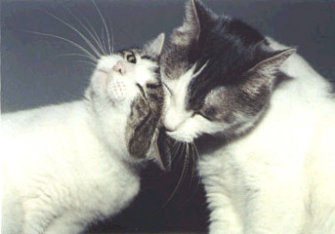
  Codes and Standards
This corporation is ISO 9000 certified, and this product shall conform to all standards required to maintain that certification.
ASPCA recommendations, Oregon Laws about cruelty to animals, other states regulations shall be investigated for relevance to this product.
The primary product certification shall be obtained from Underwriters Laboratories. This product shall receive a U/L listing prior to market release.
The product shall be configurable to meet all national and state occupational and consumer safety standards of the United States and Great Britain.
The standards and codes of the following organizations shall be followed where applicable: U/L, NIOSH, OSHA, ISO 9000, IEA, NEMA, NEC, NFPA, NBS, DOT, NCPSC, ASME, IEEE, ANSI, state OSHA, and EPA.

Slide 10
  Ergonomics
  Programming instructions for the electronic timer must be easily read and understood by someone with an education level equivalent to sixth grade.
  Product must be easy to unpack and set up.
  The results of the user survey shall be used to influence balance, overall shape, control switch type and placement, weight, style of digital display, type and placement of storage bin and lid, and dish shape and orientation.
  IEA guidelines shall be researched by the design team and followed wherever prudence dictates.
Animal issues:
Product must be difficult to tip over.
Food portion must be completely accessible, no crevices or crannies in the dish.

Slide 11
  Customer Profile
    Consumer likes and dislikes - Middle to upper-income, educated, one to five pets in the home, suburban or rural homeowner.
    Occasionally buys pet supplies through internet/mail order.
    Frequently patronizes chain pet supply stores (Pets-R-Us).
    Takes pet to boarding kennel when going on long vacations
    Wishes to feed pet according to Veterinarians recommendations for quantity and schedule.
    Customers looking for quality and control, willing to pay more than existing products cost.
    Market trends - Specialty niche market, distribute through direct marketing, chain pet supply stores, non-traditional retail opportunities.
    Retailer issues - view the retailer as a customer!
    Small urban retailers not willing to stock the product.
    Seek out other outlets, such as rural feed and seed stores, remote Veterinary offices with large animal practice.

Slide 12
    Quality and Reliability
    1 Year Replacement Warranty
    Competition warranties – 90 days
    Goals: The design team shall set product quality and reliability goals in accordance with organization policies.
  Shelf life
    Shelf life shall be indefinite.
    Stale product shall be recalled from the distributor level for repackaging and redistribution.
  Policies, processes and procedures
This organization is ISO 9000 certified, and all organizational policies and procedures shall be followed for all design processes. Such documents shall be made available for all design team members, and all department managers shall have a copy available for any employee who wishes to see one.

Slide 13

Timescales
Design process schedule: (see attached schedule)
Milestones: (see attached schedule)
Testing
Testing of materials will be performed in accordance with organizational policies and procedures, which are defined in the ISO 9000-certified policies and procedures manual.
Production and post-market quality will be tested in accordance with organization policies and procedures for quality assurance.
Manufacturing testing metrics and procedures shall be set by the design team and administered by the quality control department.
Market penetration testing metrics and goals shall be designed and administered by the sales department.

Slide 14
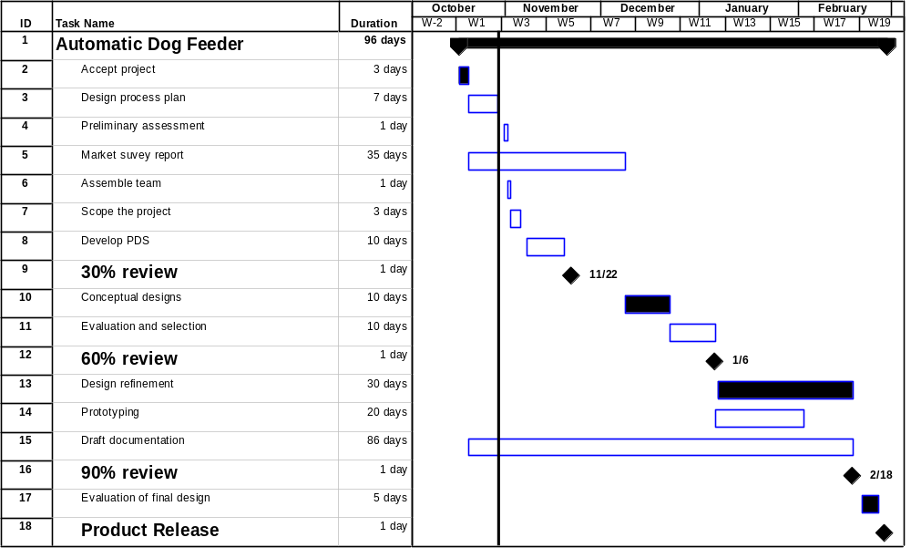
Timescales
Design process schedule:

Slide 15
Safety
Warning labels must be provided warning against all foreseeable risks due to electrical and mechanical components.
Product must be designed to anticipate some abuse or misuse.
Assessment of risk and conformance to national (NEMA, OSHA, NBS, NIOSH) and state safety guidelines shall be performed by a contracted safety consultant under the direction of the legal department.
Warning labels shall be approved by the legal and quality (consumer complaint) departments.
Company constraints
The aesthetic design features shall meet organizational policy with respect to cosmetic brand-identifying features, trademarks and characteristic styling.
New design capacity shall be added to support engineering efforts that surpass the capability of existing design staff and technology.
The manufacturing department shall participate in the review process and shall be represented on the design team to ensure that designs can be implemented in accordance with manufacturing policies and procedures.
Human Resources
Personnel estimates are expressed in the following table:

Slide 16
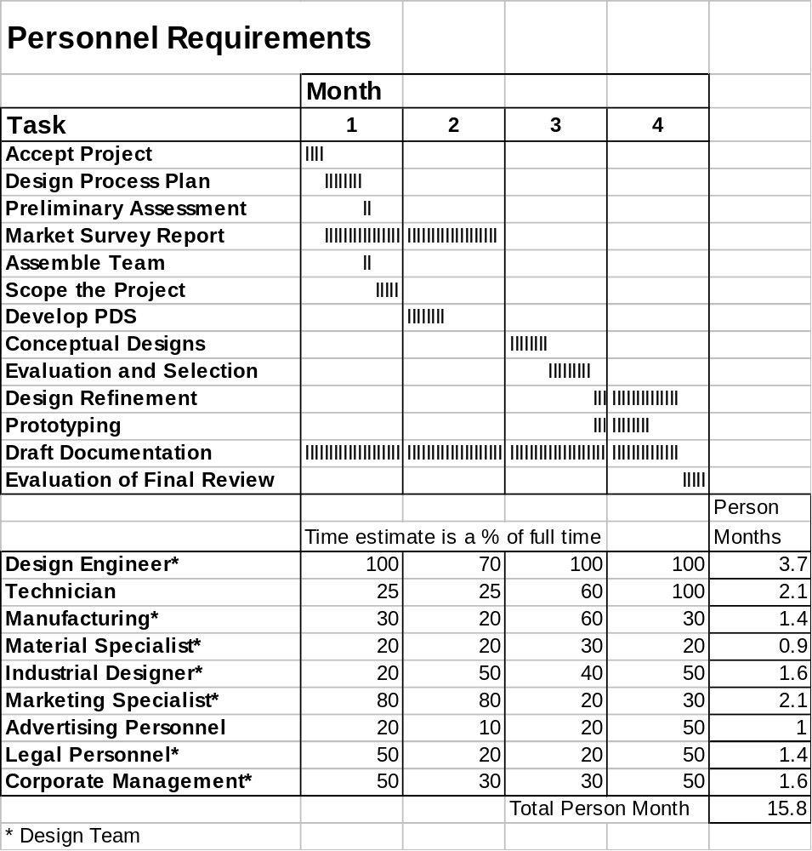

Slide 17
  Market constraints
    The product must not violate social, legal, or cultural constraints with respect to the care and feeding of household pets.
    The timer control must not be capable of accepting a program that could be deemed insufficient to maintain the life of an average household dog or cat.
Use of this product in zoo or agricultural environments must be characterized as outside the design range of the product , and any such use requires the end-user to perform an independent appraisal of the suitability of this product for their application.

Slide 18
  Legal
All legal matters, contracts, product safety measures and safety consultant reports shall be reviewed for errors and omissions by the legal department. Patent searches for competitive products shall follow the design process, concurrently identifying proprietary rights conflicts as the focus of design function progresses.
The design team is responsible for performing research to identify patents or proprietary claims that infringe on design ideas under consideration, and the legal department is responsible for reviewing and guiding that research.
The legal department shall be responsible for: Researching pending litigation for personal injury or property damage claims arising from similar products; researching product recalls or product liability issues; and resolving any proprietary claims prior to product release.
Patent applications for designs created during the project shall be completed prior to release of the product into the market.

Slide 19
  Installation
    Documentation supplied with the product shall contain simple instructions for unpacking the unit, setting it up, filling the storage bin and plugging it into a wall outlet.
    Set up procedures shall be simple and obvious to the average consumer, and shall be designed in a fail-safe manner so that mistakes do not damage the product.
  Disposal
The product body shall be made from recyclable plastic.

Slide 20
  Documentation.
    Organizational policies and procedures shall govern the production and control of all documents produced during the life of the product.
    Documentation shall include the following:
    Scope and design process plan
    PDS
    Progress reports (design reviews)
    Drawings
    Draft design report
    Final report
    Parametric research (market, patent, codes, surveys)
    Operation manual
    Warranty
    Safety manual

